Slide 1

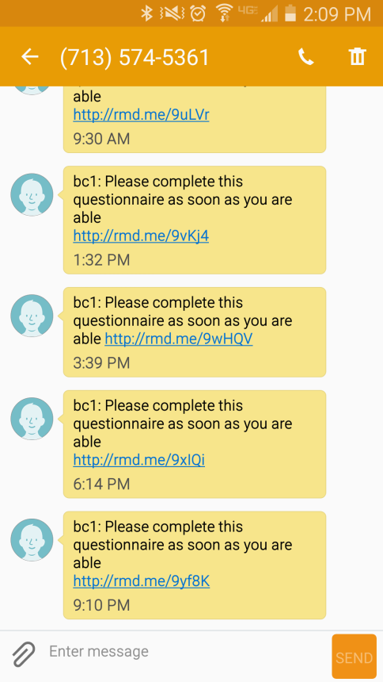
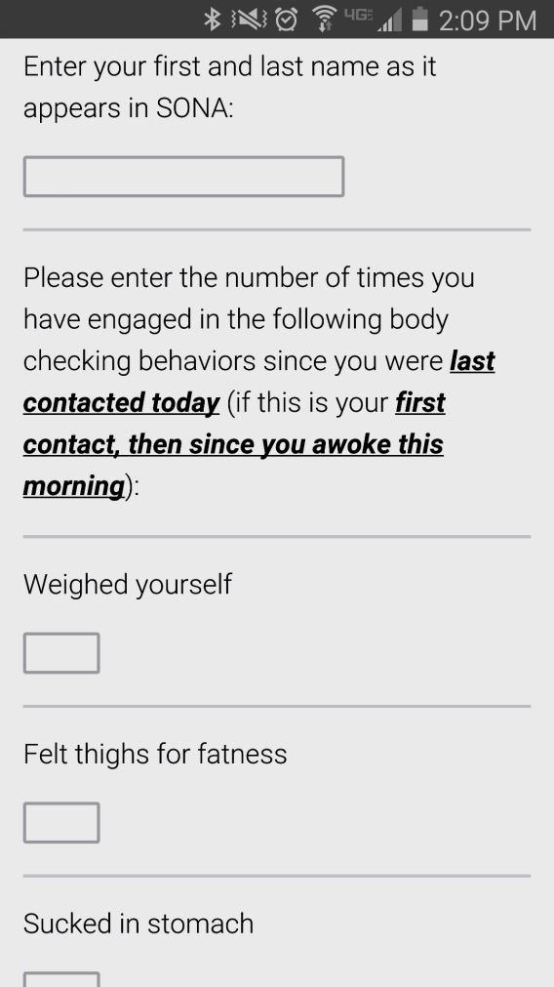
Examination of an Ecological Momentary Intervention on Body Checking and Body Dissatisfaction
Jamie M. Smith, Jen A. Battles, Madison L. Johnson, Brooke L. Whisenhunt, Erin M. Buchanan, and Danae L. Hudson
Abstract
Body checking includes behaviors such as repeatedly looking in the mirror and weighing oneself. The current study assessed the impact of an Ecological Momentary Intervention (EMI) targeting body checking. Ecological Momentary Intervention is a method of treatment that is provided in participants’ naturalistic environments utilizing mobile technology and has been shown to reduce psychological symptoms such as anxiety and stress. Forty-four undergraduate female participants completed a battery of assessments at pretest and posttest that measured body dissatisfaction, body checking behaviors and cognitions, body image avoidance, and thin-ideal internalization. Participants completed five experimental days during which they received messages via their smart phones five times per day asking them about the number of times they had engaged in eight different body checking behaviors. Additionally, on experimental days four and five, participants also received an intervention (psychoeducation, cognitive, and behavioral strategies) at every other time point. Body checking behaviors were impacted the greatest following the intervention, showing a decrease in frequency pre to post treatment. Body dissatisfaction, body image avoidance, thin-ideal internalization, and body checking cognitions modestly decreased following the intervention. These results suggest that a five-day EMI intervention can have a positive impact on a range of attitudes and behaviors and may serve as a useful clinical tool.
Method
Participants
44 female undergraduates, mean age = 18.39 (SD = 0.58)
White: n = 40 (90.9%), African American: n = 2 (4.5%), Other: n = 3 (6.8%)
BMI Mean = 21.83 (“healthy” range, SD = 1.88)
Pre/Posttest Measures
Body Shape Questionnaire (BSQ; Cooper et al., 1987)
Body Checking Questionnaire (BCQ; Reas et al., 2002)
Body Checking Cognitions Scale (BCCS; Mountford, Haase, & Waller, 2006)
Body Image Avoidance Questionnaire (BIAQ; Rosen, Srebnik, Saltberg, & Wendt, 1991)
Sociocultural Attitudes Towards Appearance Scale (SATAQ-3; Thompson, van den Berg, Roehrig, Guarda, , & Heinberg, 2004)
EMA Measure
Body checking behaviors (8 common behaviors from Stefano, et al., in press)
Procedures
Participants completed a pretest (qualified for five day EMI if they were healthy weight, had smart phones, and had high trait levels of body checking).
Completed five experimental days, received EMA measure prompt 5 times daily
During the fourth and fifth day, participants also received an intervention at every other time point
Participants then completed a post test
Interventions
Five interventions consisting of psychoeducation, visualization, and cognitive-behavioral strategies to reduce checking
“Imagine yourself standing in front of a full length mirror wearing only a swimsuit. Now, think about focusing on all the parts of your body that you dislike.
What would your mood and feelings about your body be like after doing this?
Compare this imaginary experience to what occurs when you engage in a lot of body checking. How are those experiences similar or different?”
Results
A series of dependent t-tests were conducted to analyze changes in the pre and posttest measures given before and after the five day EMA/EMI intervention.
All five measures displayed healthy changes after the intervention.
Body checking seemed to be impacted the greatest, representing a large effect size.
Body dissatisfaction, body image avoidance, internalization of the thin-ideal, and body checking cognitions all decreased moderately.
Table 1. Means of Pre and Post Test Scores.
Model | Pretest M (SD) | Posttest M (SD) | t | d
BSQ | 130.00 (24.35) | 113.95 (29.18) | -5.11** | .77
BCQ | 82.61 (8.11) | 67.16 (15.43) | -7.51** | 1.13
BIAQ | 41.45 (11.63) | 34.20 (11.75) | -5.18** | .78
BCCS | 61.23 (10.90) | 53.52 (15.67) | -3.29* | .50
SATAQ-3 | 115.80 (15.14) | 107.10 (19.87) | -4.09** | .62
Note. * = p < .002, ** = p < .001.
Introduction
Body checking, or engaging in any behavior that leads to body evaluation, includes behaviors such as repeatedly looking in the mirror, weighing oneself, and wrapping the hand around parts of the body such as the stomach, waist, thighs, or arms (Walker & Murray, 2012).
Body checking behaviors have been found to increase body dissatisfaction, attentional bias for body-related information, and body-related self-critical thoughts (Walker, 2014; Smeets et al., 2011; Shafran et al., 2007).
Fairburn’s (2003) Enhanced Cognitive-Behavioral Therapy for Eating Disorders identifies body checking as serving a maintaining role in the over evaluation of shape and weight among individuals with eating disorders.
Currently, no studies have addressed digital treatments for body checking behaviors.
Ecological Momentary Intervention (EMI) is a method of treatment that is provided in participants’ naturalistic environment utilizing mobile technology and has been shown to reduce psychological symptoms such as anxiety and stress (Heron & Smyth, 2010; Gee, Griffiths, & Gulliver, 2016).
Purpose
To assess the impact of an Ecological Momentary Intervention (EMI) on body checking behavior.
Hypothesis
Body checking, body checking cognitions, body dissatisfaction, body image avoidance, and internalization of the thin-ideal will significantly decrease following a five day intervention.
Discussion
Healthy changes were found in body checking, body dissatisfaction, body image avoidance, internalization of the thin-ideal, and body checking cognitions after the five day intervention.
These results add to the current EMI literature suggesting that interventions delivered in the moment can effectively impact a range of health behaviors (Heron & Smyth, 2010).
The lack of a control group for this study hinders the ability to be certain changes were due to the intervention.
Future research can continue to examine body checking interventions that are delivered in the moment by utilizing control groups in study designs and developing more personalized interventions for individuals that are delivered at personalized times.
References
Cooper, P. J., Taylor, M. J., Cooper, Z., & Fairbum, C. G. (1987). The development and validation of the Body Shape Questionnaire. International Journal of eating disorders, 6(4), 485-494.
Fairburn, C.G., Cooper, Z., & Shafran, R. (2003). Cognitive-behaviour therapy for eating disorders: A ‘‘transdiagnostic’’ theory and treatment. Behaviour Research and Therapy, 41, 509–528.
Gee, B. L., Griffiths, K. M., & Gulliver, A. (2016). Effectiveness of mobile technologies delivering Ecological Momentary Interventions for stress and anxiety: a systematic review. Journal of the American Medical Informatics Association, 23(1), 221-229.
Heron, K. E., & Smyth, J. M. (2010). Ecological momentary interventions: Incorporating mobile technology into psychosocial and health behaviour treatments. British Journal Of Health Psychology, 15(1), 1-39. doi:10.1348/135910709X466063
Mountford, V., Haase, A., & Waller, G. (2006). Body checking in the eating disorders: Associations between cognitions and behaviors. International Journal Of Eating Disorders, 39(8), 708-715. doi:10.1002/eat.20279
Reas, D. L., Whisenhunt, B. L., Netemeyer, R., & Williamson, D. A. (2002). Development of the body checking questionnaire: A self‐report measure of body checking behaviors. International Journal of Eating Disorders, 31(3), 324-333.
Rosen, J. C., Srebnik, D., Saltzberg, E., & Wendt, S. (1991). Development of a body image avoidance questionnaire. Psychological Assessment: A Journal Of Consulting And Clinical Psychology, 3(1), 32-37. doi:10.1037/1040-3590.3.1.32
Shafran, R., Lee, M., Payne, E., & Fairburn, C. (2007). An experimental analysis of body checking. Behaviour Research And Therapy, 45(1), 113-121.
Smeets, E., Tiggemann, M., Kemps, E., Mills, J. S., Hollitt, S., Roefs, A., & Jansen, A. (2011). Body checking induces an attentional bias for body‐related cues. International Journal of Eating Disorders, 44(1), 50-57.
Thompson, J. K., van den Berg, P., Roehrig, M., Guarda, A. S., & Heinberg, L. J. (2004). The Sociocultural Attitudes Towards Appearance Scale-3 (SATAQ-3): Development and validation. International Journal Of Eating Disorders, 35(3), 293-304. doi:10.1002/eat.10257
Walker, D. C. (2014). An experimental manipulation of body checking and mirror exposure over time in men and women with high shape or weight concern. Dissertation Abstracts International, 74.
Walker, D. C. & Murray, A. D. (2012). Body image behaviors; Checking, fixing, and avoiding. Encyclopedia of Body Image and Human Appearances, 1, 166-172.
For more information, contact Jamie Smith at Jamie999@live.missouristate.edu

